Slide 1
Alleviating Regulatory Impediments To Native Shellfish Aquaculture

Slide 2
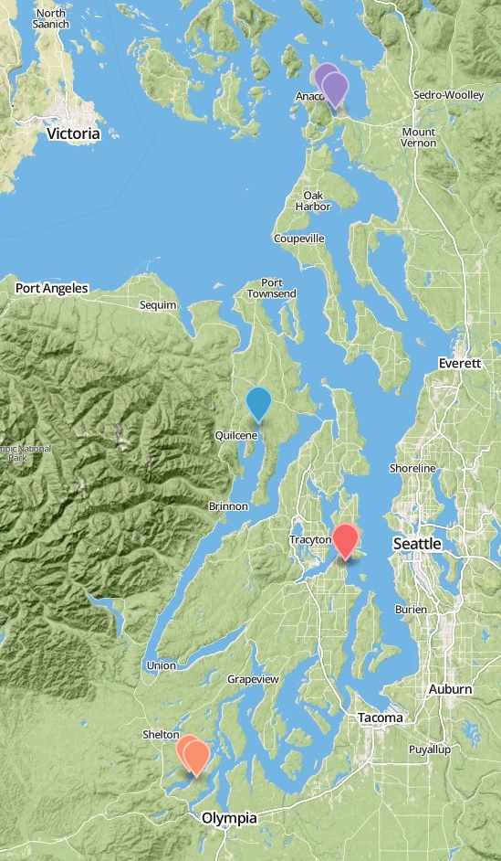
Issue at Hand
What levels of genetic and epigenetic variation are present among Olympia oysters populations in Puget Sound basin?
What are the implications for restoration and commercial aquaculture practices?
10 miles

Slide 3
Project Plan and Aims
Project Plan:
Reciprocal transplant of Olympia oysters from Fidalgo, Dabob, and Oyster Bays as well as transplants in Manchester
Monitor Growth, Mortality, and Reproductive Success in situ
Subsample survivors after major mortality events
Characterize genetic and epigenetic profiles
Compare differences in in situ metrics with changes in genetic diversity profiles
Project Aims:
Measure relative fitness of all populations at all sites to determine if the phenomena of local adaptation exists in Olympia oysters
Investigate genomic basis of local adaptation
Provide useful information for restoration and commercial production of Olympia oysters

Slide 4
Map
Sites located on North-South Axis
Purple = Fidalgo
Blue = Dabob
Orange = Oyster Bay
Red = Manchester*
*Manchester only has transplants, no native oyster population.
Interactive map can be accessed here:
http://bit.ly/1l2vNu6
10 miles

Slide 5
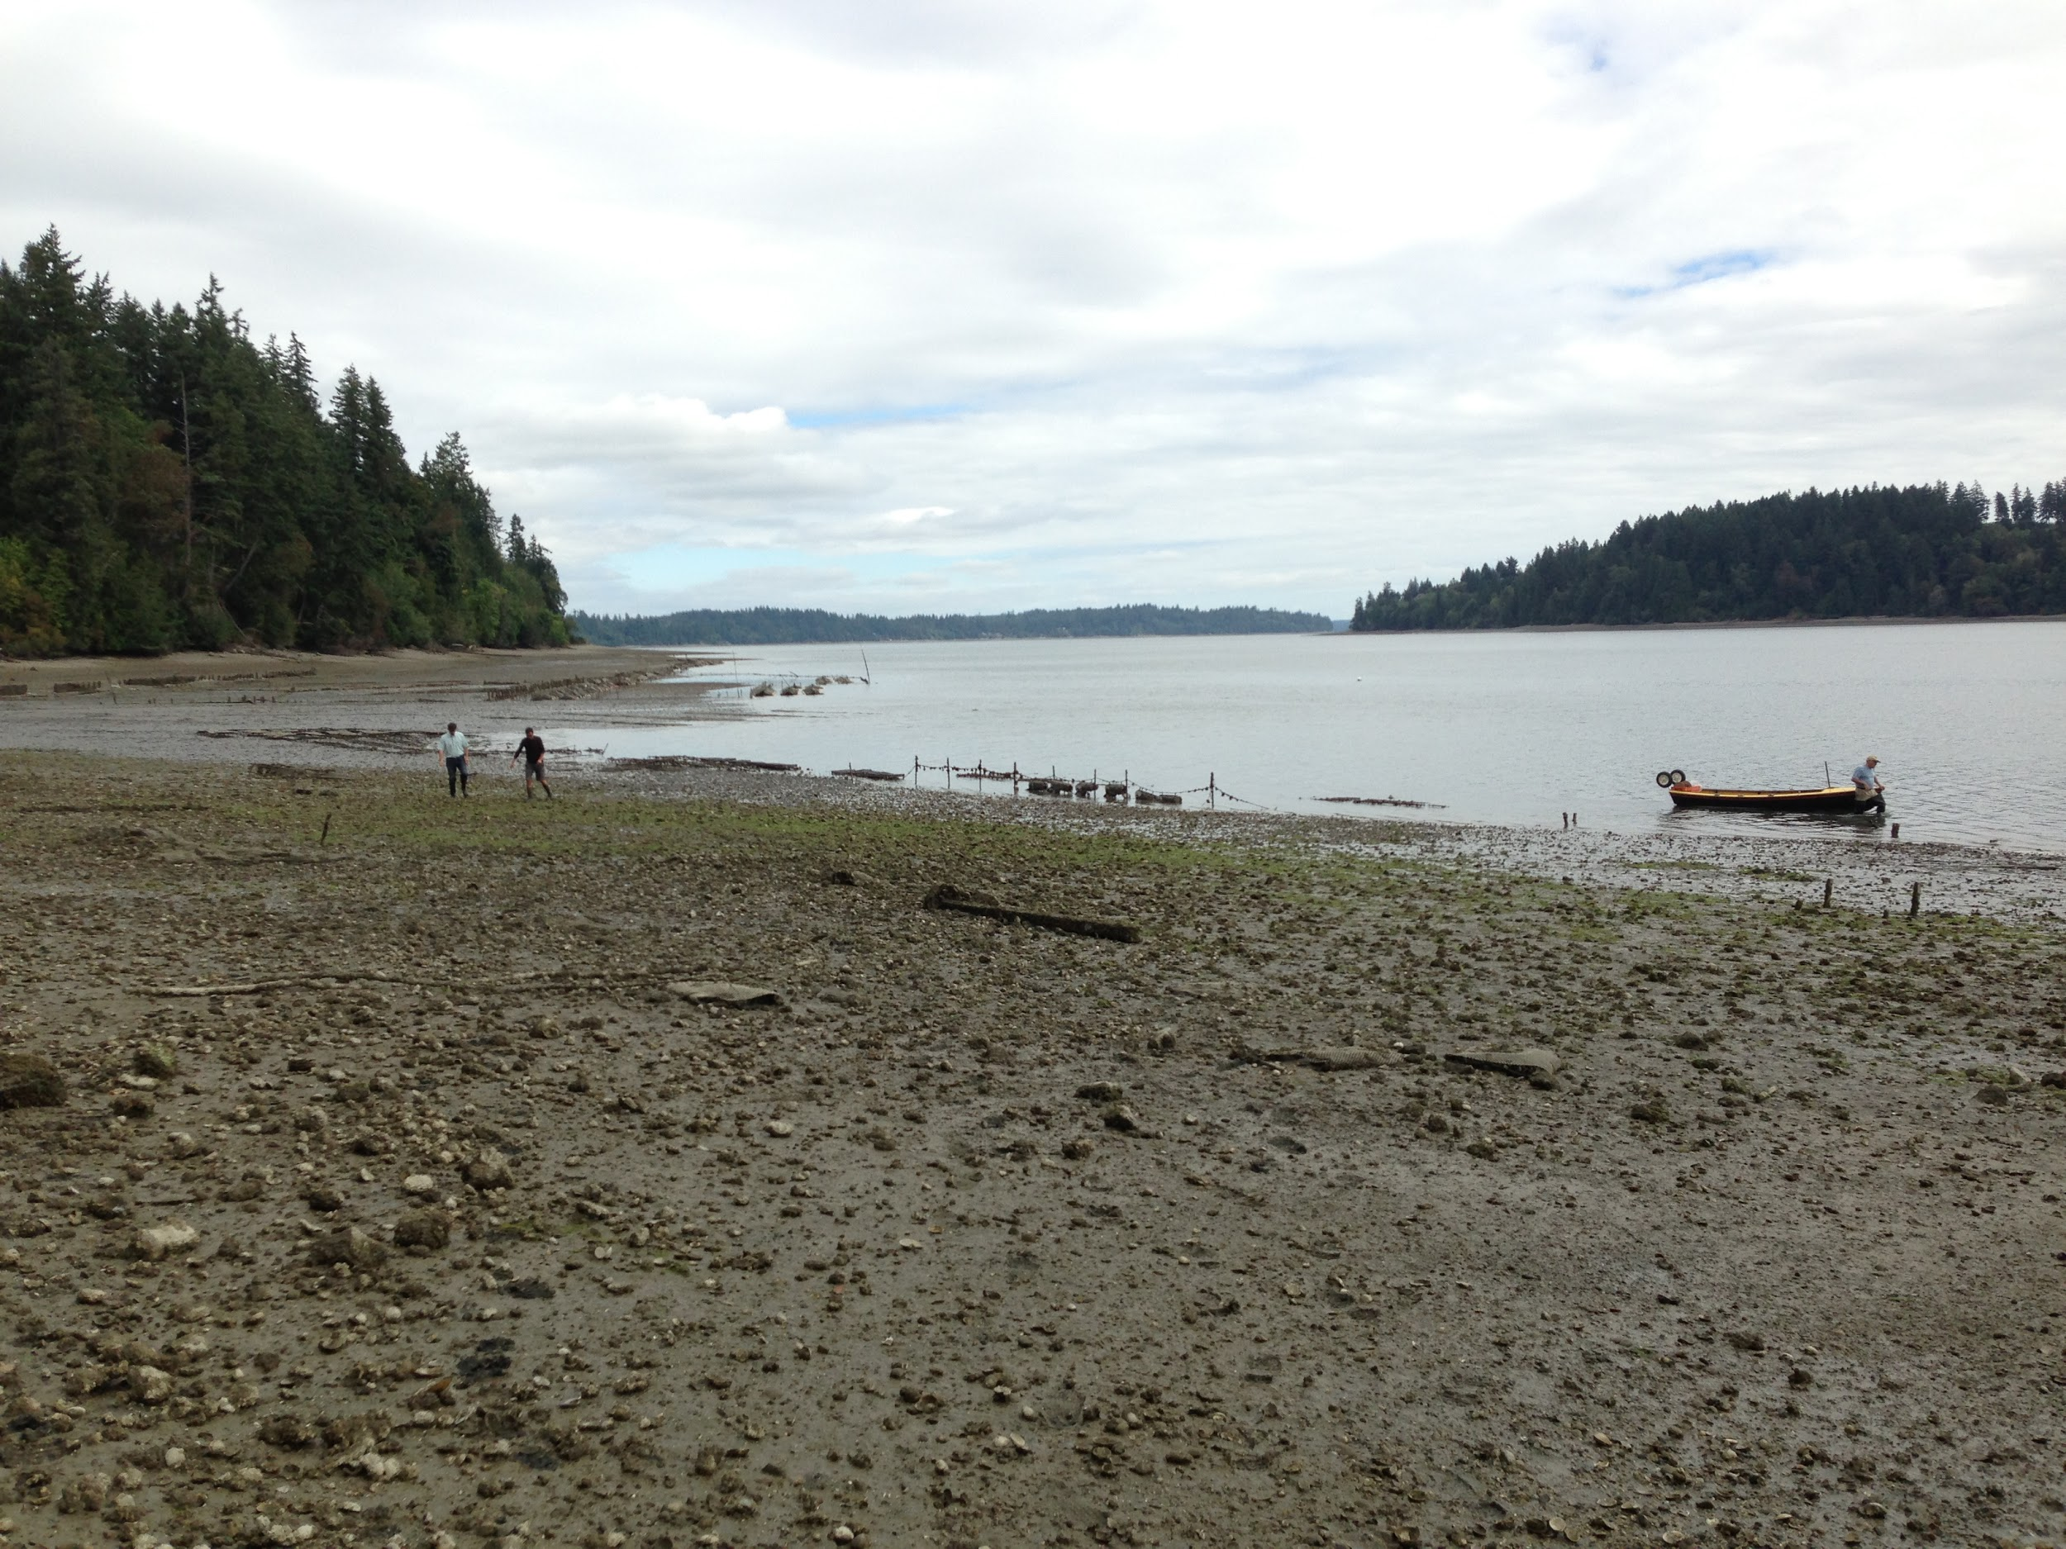
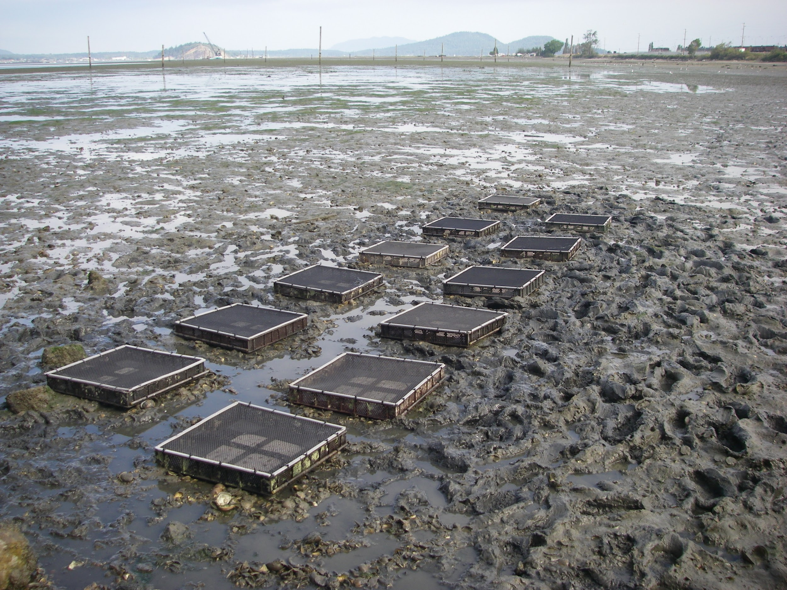
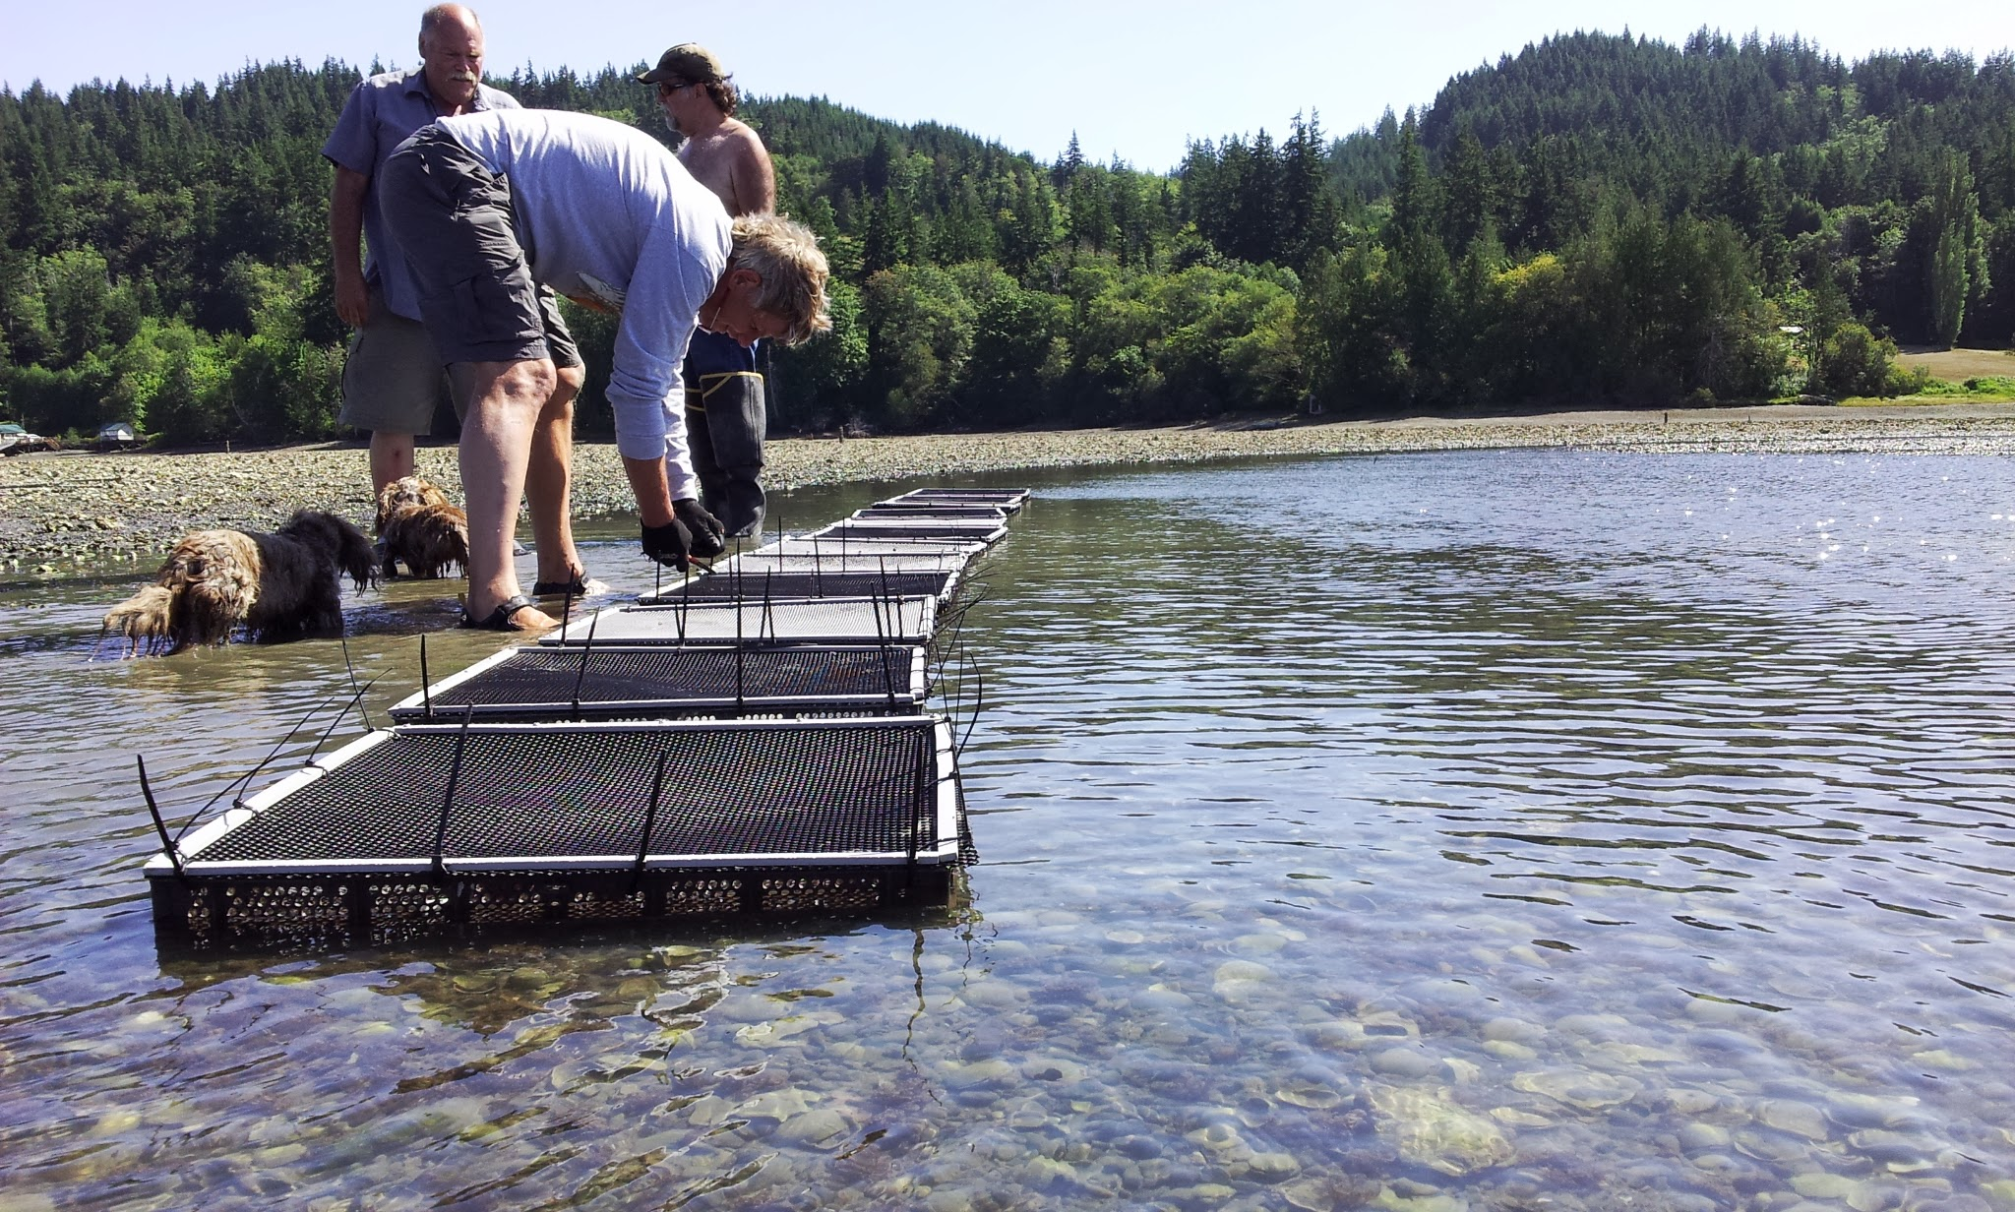
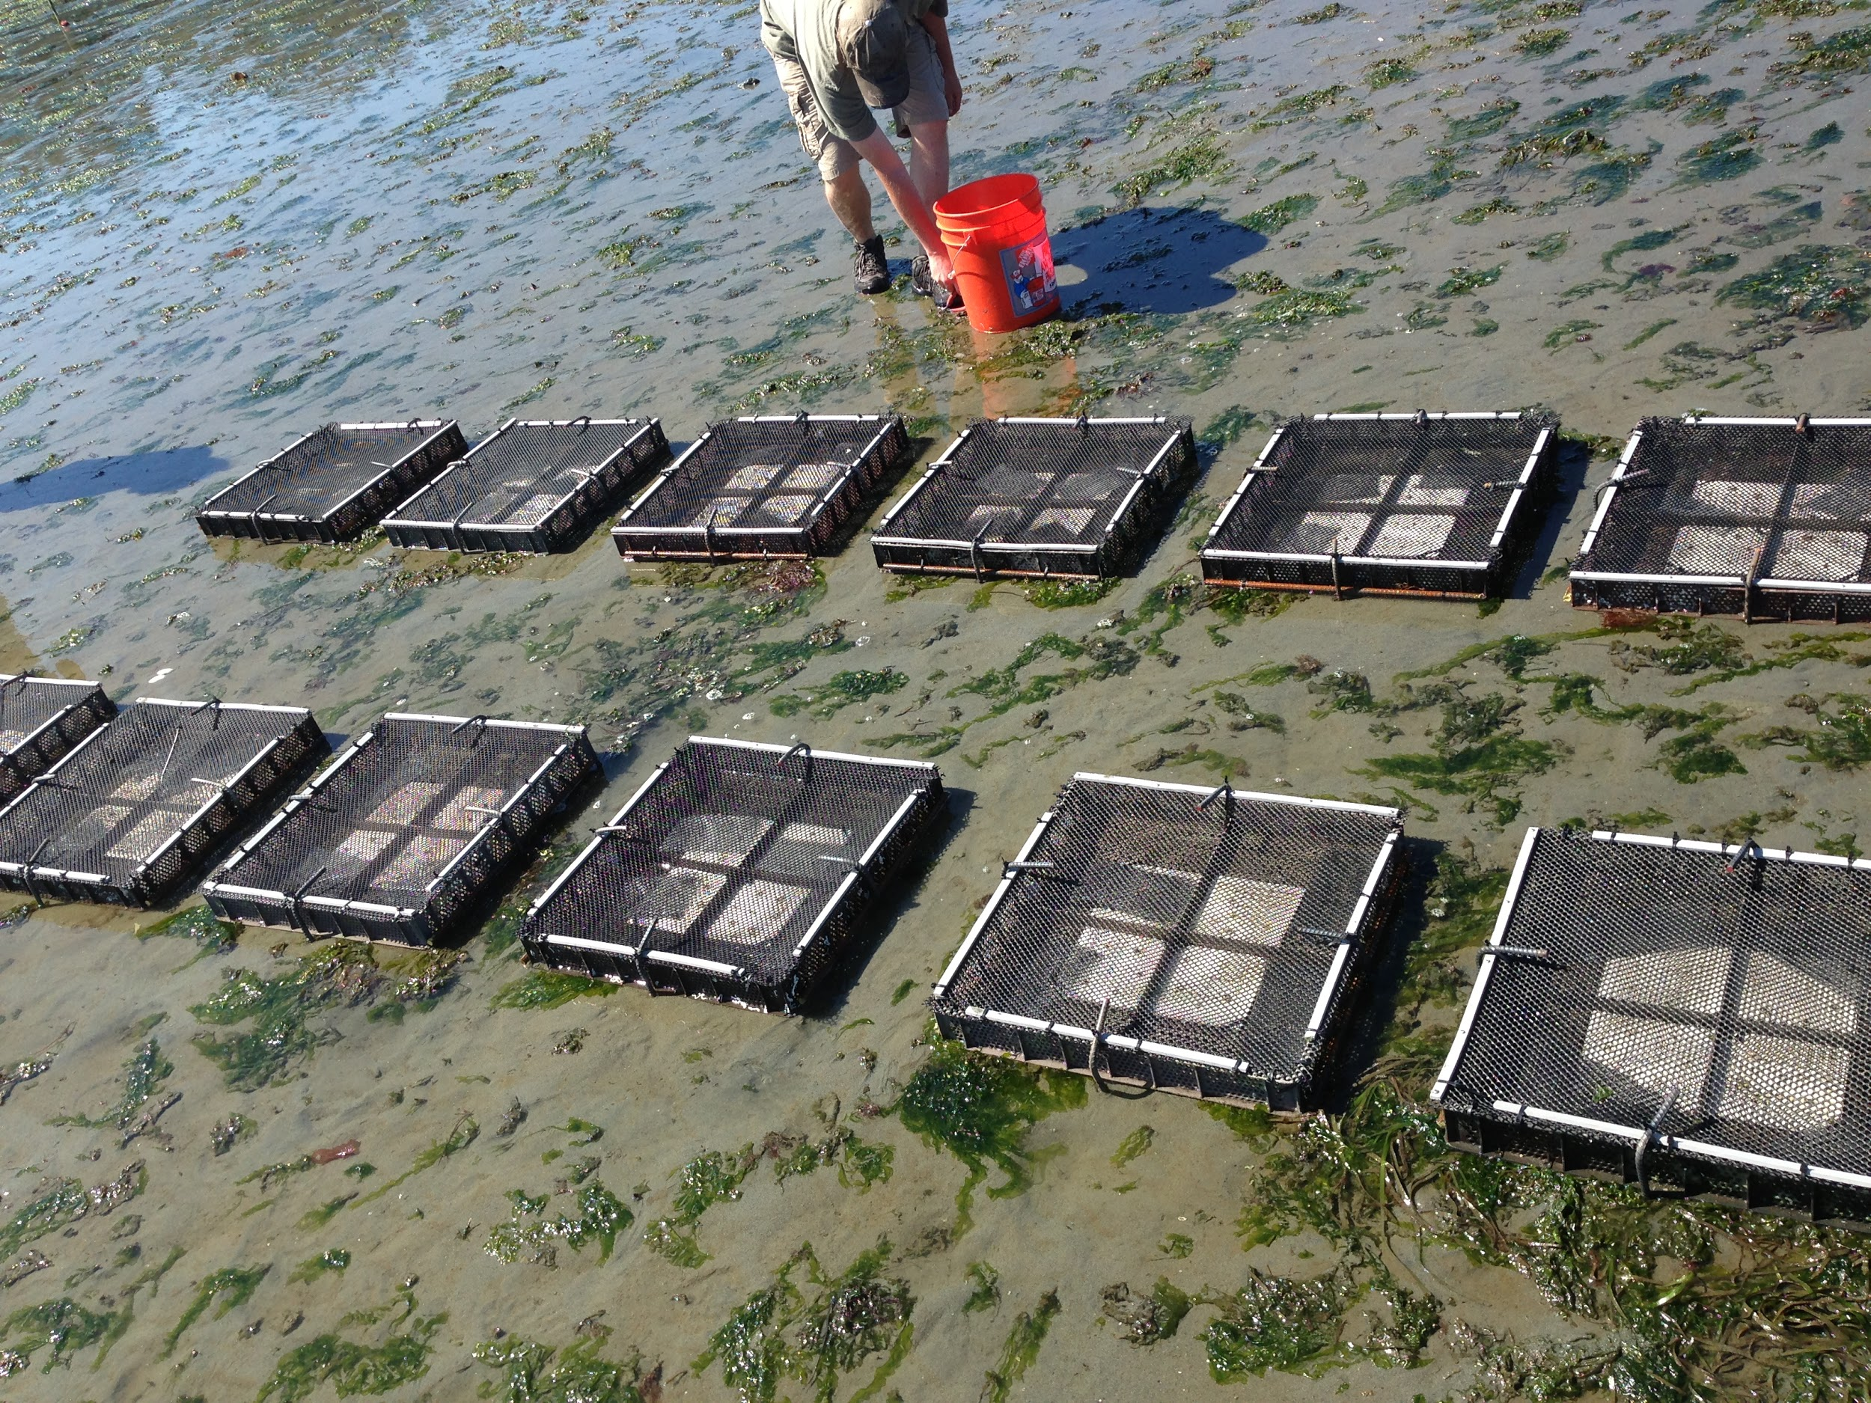
Oyster Bay,
Fagergren Shores
Fidalgo Bay,
Tommy Thompson Trestle
Dabob Bay,
Long Spit
Rock Point Oyster Company
Manchester NOAA,
Tidal Flat

Slide 6
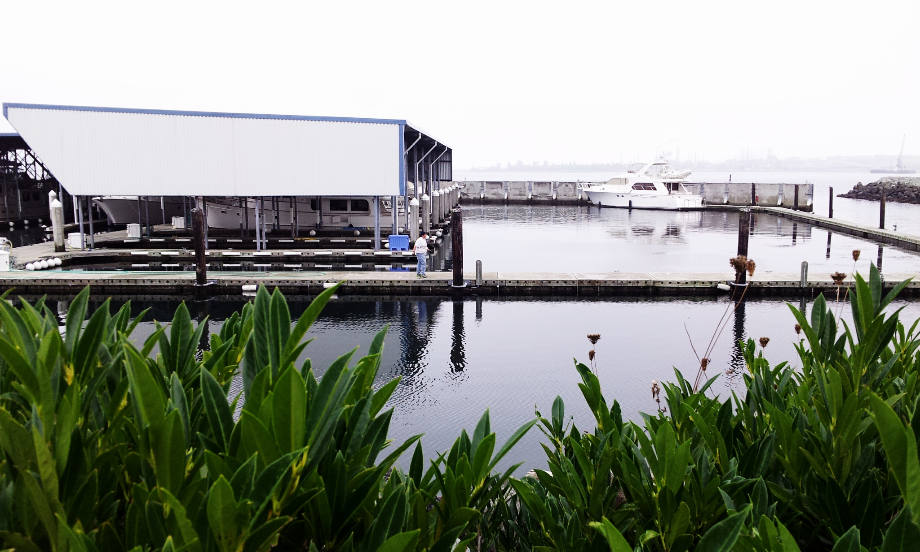
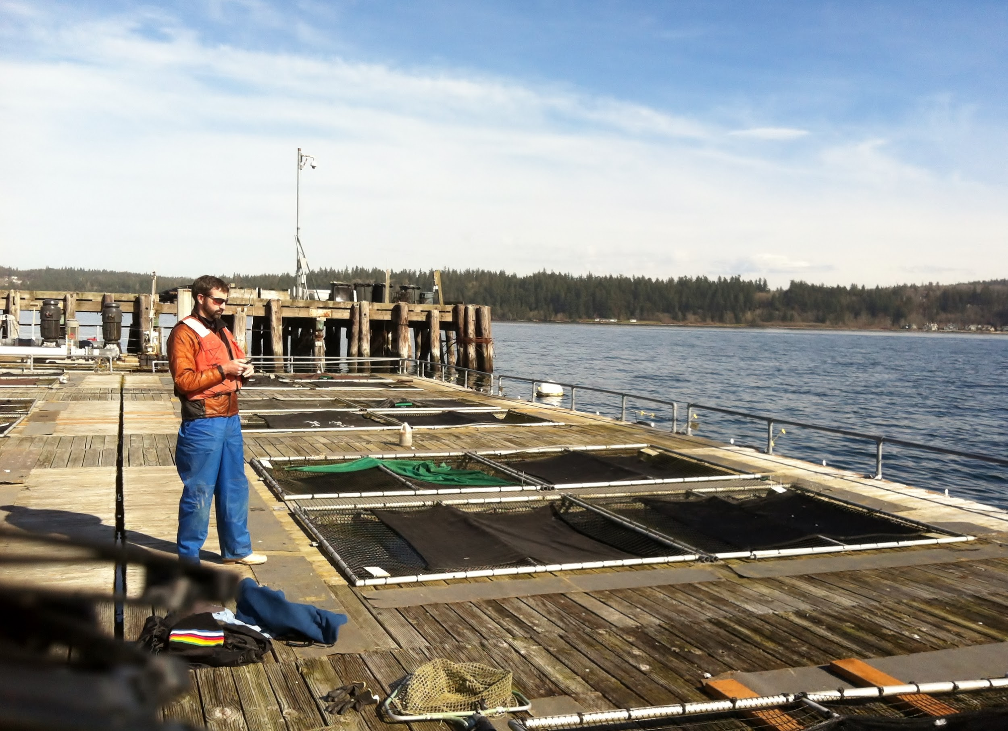
Sites
Oyster Bay,
Crab Fresh Inc.
Fidalgo Bay,
Fidalgo Marina
Manchester NOAA,
Aquaculture
Net Pens
Dabob Bay,
Long Spit
Rock Point Oyster Company

Slide 7
Broodstock / Offspring
PSRF Collected Broodstock from each location Nov/Dec 2012
Originated from intertidal zones (-1 to -2 ft sea level)
Conditioned 1 month prior to spawning
Oysters spawned in origin based groups May/June 2013
Maintained separately in common garden throughout.
Larvae collected upon swarming
Grow out occurred in flow through system
Spat set upon microcultch
In nursery until August 2013 outplanting

Slide 8
Timeline
Nov/Dec 2012
Broodstock Collected
August 2013
Oysters Outplanted
November 2013
Manchester Moved
January 2014
Dabob Sampled
May/June 2013
Oysters Spawn
October 2013
Fidalgo, Oyster Bays Moved
December 2013
All Sites Sampled
February 2014
Fidalgo, Manchester, and Oyster Bays Checked

Slide 9
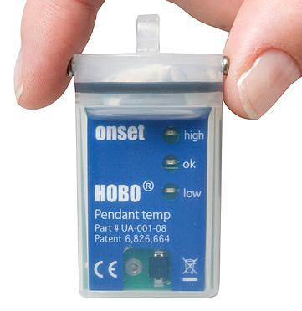
Environmental Monitoring
HoboLogger Temperature Monitors
Placed at each site
Record temp every 15 minutes

Slide 10
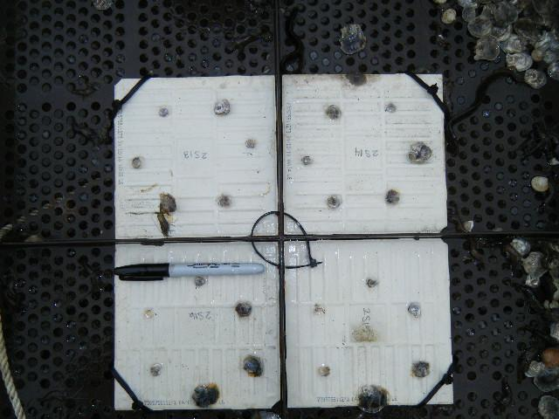
Growth/Mortality Monitoring
Growth Monitoring
Shell Length
  Live Subsamples measured in lab
  Image Analysis Program (ImageJ)
Weight
  Live Subsamples weighed in shell
Mortality
Live Census
  Total census of living oysters
  Partial census of living oysters (Dabob Dec 2013)
Dead Census

Slide 11
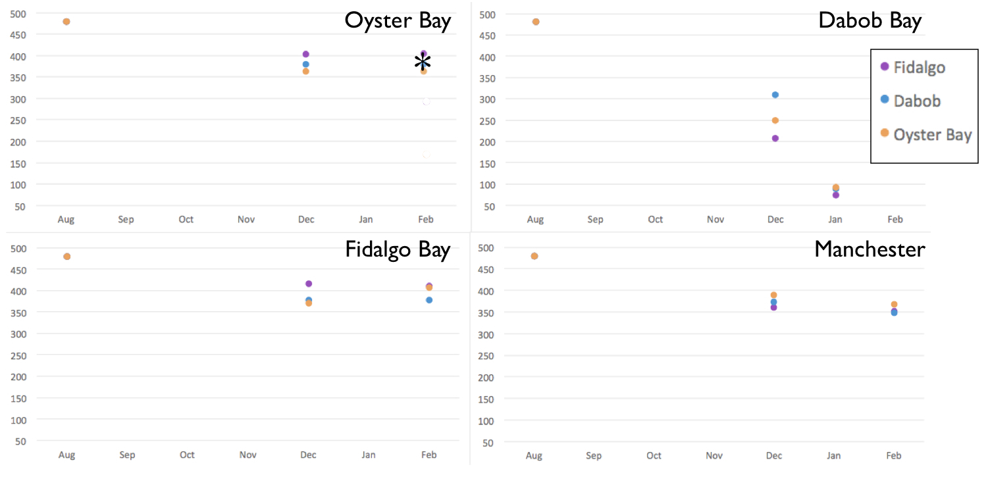
Growth/Mortality Monitoring
* denotes missing trays
Number of Oysters

Slide 12
Map
Sites located on North-South Axis
Purple = Fidalgo
Blue = Dabob
Orange = Oyster Bay
Red = Manchester*
*Manchester only has transplants, no native oyster population.
Interactive map can be accessed here:
http://bit.ly/1l2vNu6
10 miles

Slide 13
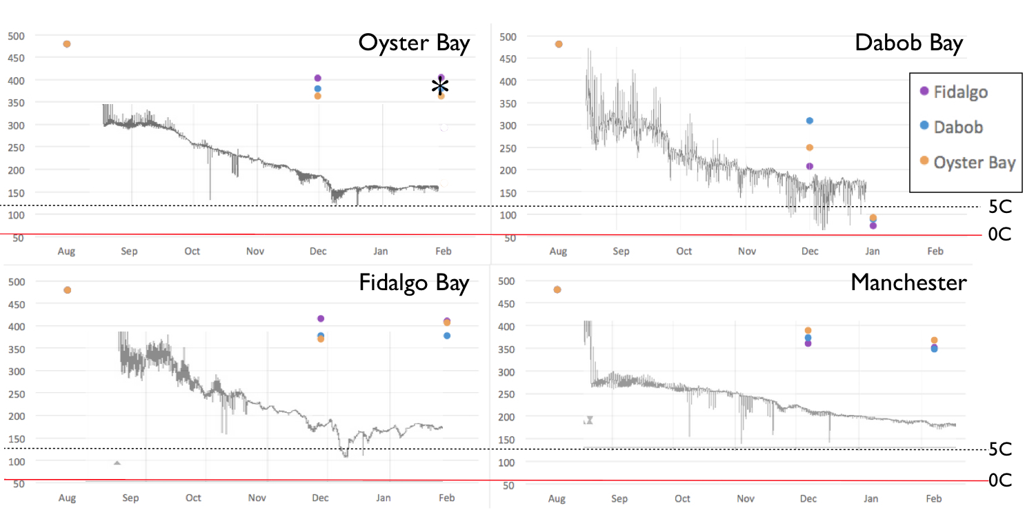
Growth/Mortality Monitoring

Slide 14
Growth/Mortality Monitoring
Moved
Moved
Moved

Slide 15
Map
Sites located on North-South Axis
Purple = Fidalgo
Blue = Dabob
Orange = Oyster Bay
Red = Manchester*
*Manchester only has transplants, no native oyster population.
Interactive map can be accessed here:
http://bit.ly/1l2vNu6
10 miles

Slide 16
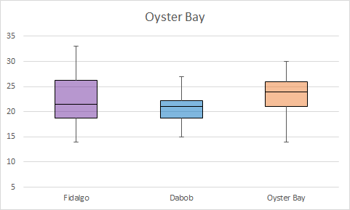
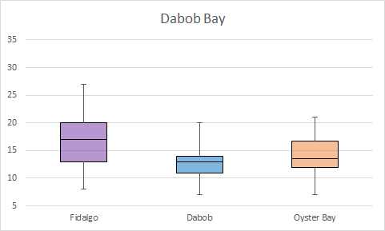
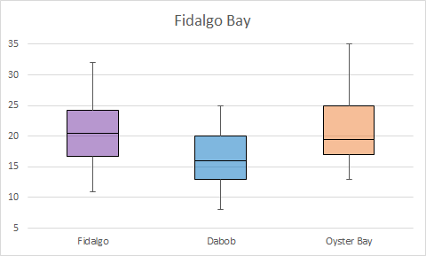
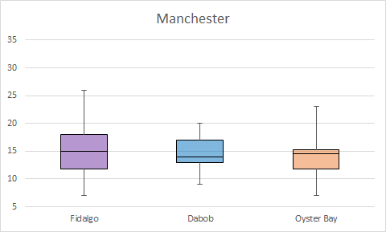
Size (mm)

Slide 17
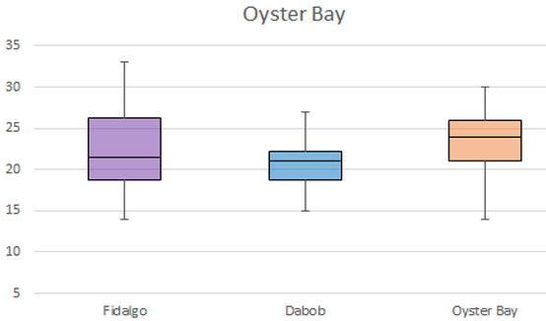
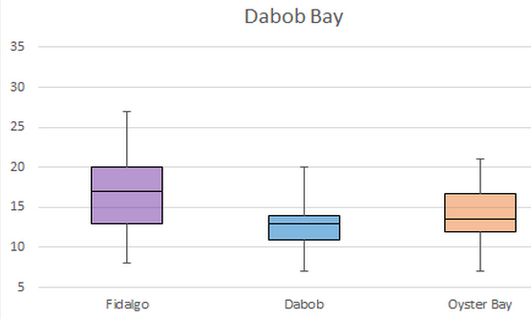
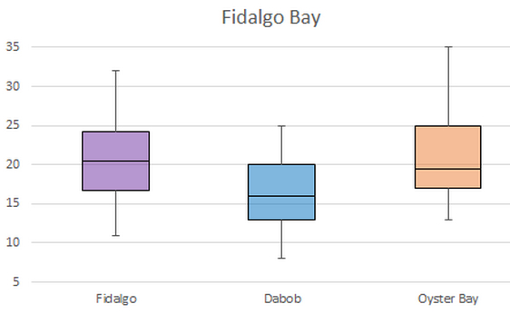
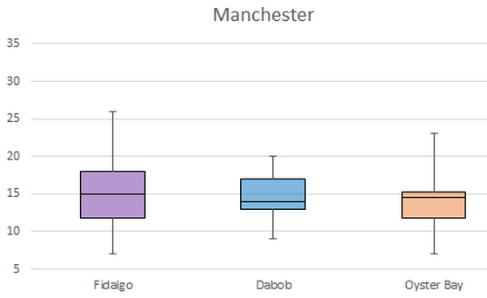
Growth/Mortality Monitoring
Moved
Moved
Moved

Slide 18
Growth/Mortality Monitoring
Growth
Difference noted between populations
May indicate allocation of resources
Mortality
Little difference at most sites
Dabob Bay difference present but diminishing

Slide 19
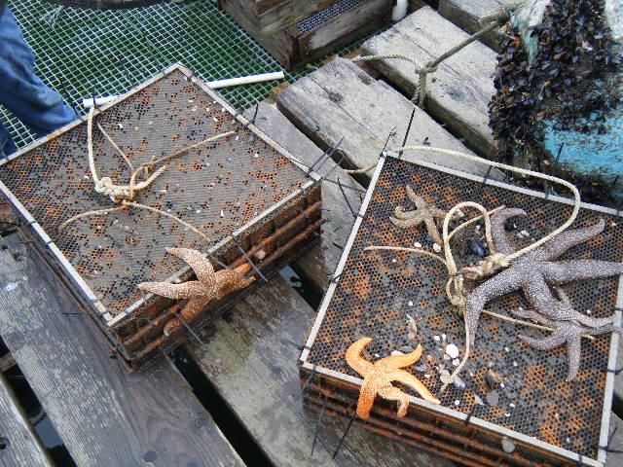
Future Work
Continue Site Monitoring
  Image Analysis (ImageJ)
  Water Quality Buoy Information
Measure Reproductive Success
  Anesthetization Method
  Larval Traps
Sequencing
  Archived Samples
  Future Mortality Event
Controlled Stress Experiments

Slide 20
Reproductive Success
Rope Attached to Trays
Anesthetization Method
Subsample treated
Brooded embryos/larvae washed out
Larval Traps
Traps hung below trays
Descending larvae caught/counted
Larval assignment tests
Larvae fall into open trap top
Larval Collection Tube
DMSO
Fixative
Anchoring Weight

Slide 21
Sequencing
Archived Samples
December 2013 All sites
  32 per pop per site Fidalgo, Manchester, and Oyster Bays
  64 per pop at Dabob
January 2014
  40 per pop at Dabob
Future Sampling
More samples post mortality event
Sampling at 1 year mark

Slide 22
Growth/Mortality Monitoring
n=32
n=64
n=40
Moved
n=32
n=32
Moved
Moved

Slide 23
Sequencing Effort
Elucidate the underlying population structures present through genomic and epigenomic diversity.
Determine if genetic diversity in native populations is threatened by introduction of foreign populations.

Slide 24
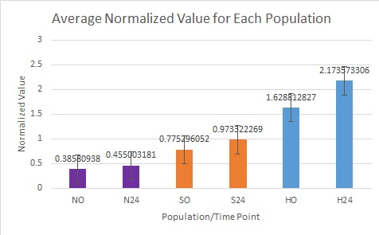
Controlled Stress Exp.
November 2013 Pilot Study
Mild Stress for 24 hours
Different Responses
Future Study
Chronic Stressor for 1 month
Sample all Pops 1 per week
Compare difference in responses

Slide 25
Big Questions!
Is any observed differential mortality driven by genomic and/or epigenomic differences?
Does habitat affect reproductive success and select for genomic profiles most fit for habitat?
Do genomic and epigenomic diversity converge on profiles associated with highest fitness in each habitat?
Would transplants have any effect on native populations?

Slide 26
Conclusion
Monitoring shows trends
Continued monitoring important
This reproductive season is key
Genetic and Epigenetic Analysis
Controlled experiments

Slide 27

Acknowledgements!
NOAA Manchester
Rick Goetz, James Hackett,
NOAA Dive Team (Paul Hillman, Jon Lee, Rob Endicott, Ewann Berntson), Doug Immerman, Giles Goetz, Andy Jasonowicz
PSRF
Ryan Crim, Stuart Ryan, Brian Allen,Alex Karpoff, Betsy Peabody, and the rest of the PSRF team.
Roberts Lab
Mackenzie Gavery, Claire Olson, Sam White, Emma Timmins-Schiffman, Hannah Wear, Katie Jackson, Samantha Adams
WDFW
Brady Blake
Rich Childers
Collaborators
Bonnie Becker, Kerry Naish, Julie Barber (Swinomish Tribe), Teri King (Washington Sea Grant), L. Christine Savolainen,, Einer Sortun (Fidalgo Marina), Rock Point Oyster Company, Duane Fagergren (Fagergren Oyster Co.), Brendan Mahaffey, Jeff Koenings, and everyone at Crab Fresh. UW SAFS
Funding
Aquaculture
Program
Alleviating regulatory impediments to native shellfish aquaculture (R/LME/N-3)

Slide 28
Synergistic Efforts
- Genome Browser
- Genetics of Breeding Schemes
- Reproductive tissue transcriptomics

Slide 29
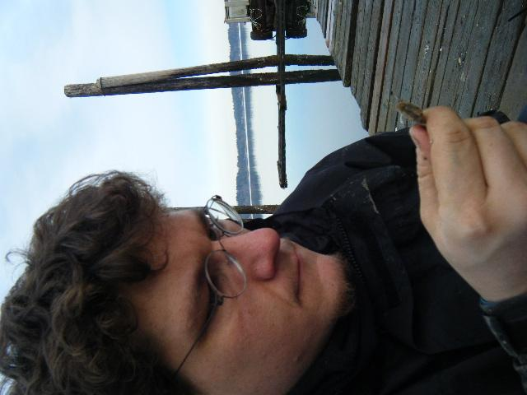
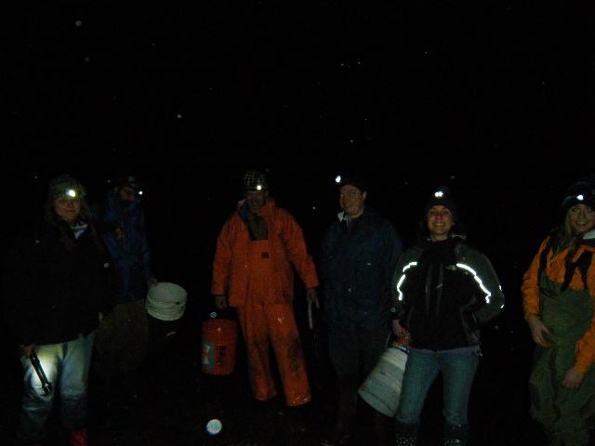
Questions

Slide 30
Additional Project Pages
Visit the pages below to learn more:
Interactive Map: http://bit.ly/1l2vNu6
Project Wiki: http://olyo.wikispaces.com/
http://oystergen.es/olympia/
Follow Jake on Twitter: @HeareBraindIdea

Slide 31
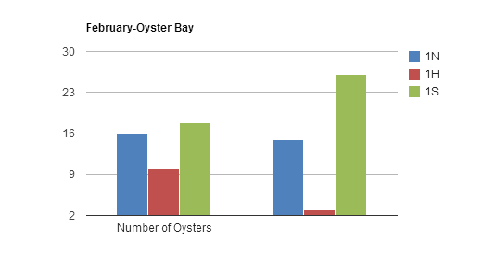
n=20

